Slide 1

GSOE9758
Project Topic: Radisson
Group number ：2
z5189004 Yu He
z5275261 Dongchen Liu
z5192843 Yuhan WANG
z5303449 Hanwei ZHANG
延时符

Slide 2
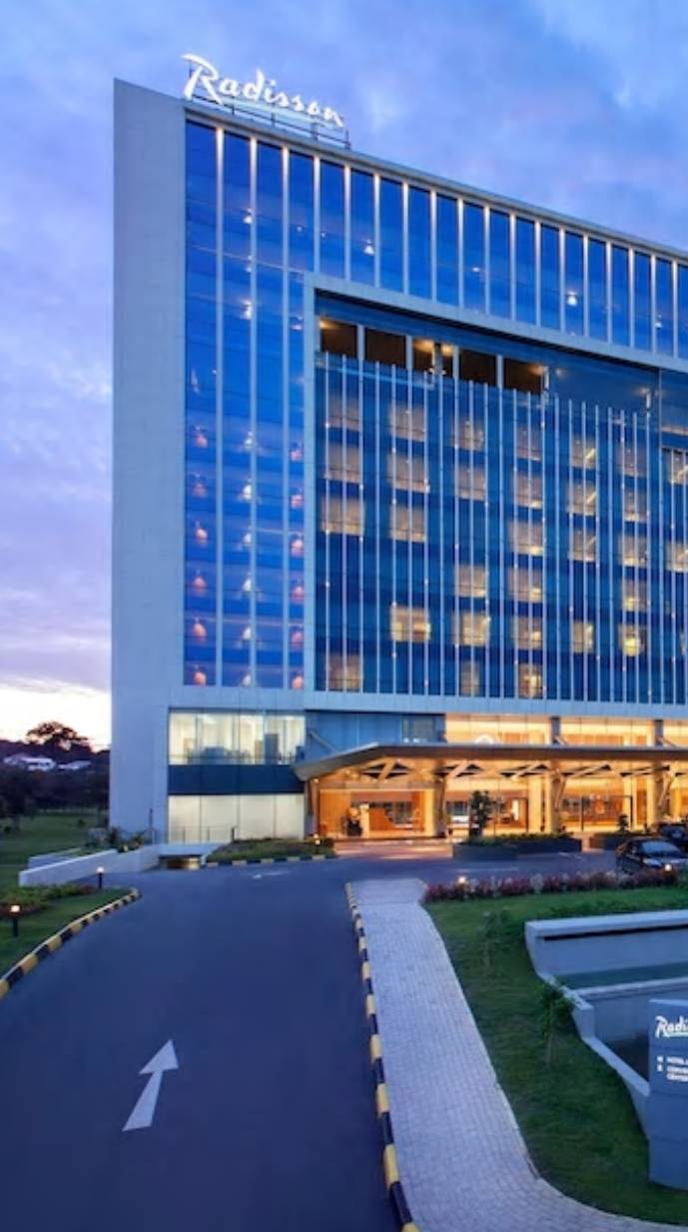
Background and History
Radisson Hospitality AB (publ) (“Radisson”) is one of the largest hotel companies in Europe, the Middle East & Africa. By the end of 2019, the group operated 387 hotels with 84,842 rooms in 66 countries.
1909 The first Radisson Hotel was opened, named after the famous French explorer Pierre Radisson.
1962 the Radisson Hotel was acquired by Minneapolis businessman and entrepreneur Curt Carlson, who pioneered the concept of a customer loyalty program.

Slide 3
Business Model Canvas
Key Partners
Government（Tax bureau，Legal aid）
Venture Capital Institution
Industry
“Service Providers” e.g. banks, cafe
Brand management manufacturer（Clothing, wineries, supermarkets）
Key Activities
Guest services
Rental service (site, technical staff, management staff)
Company mergers and acquisitions
Value Proposition consumer
Top service
Book a room online
Cooperative
enterprise
Successful business operation experience
Reputation
workers
Earn good money
Employment prospects
Relationships
24*7 Customer support
Social Media
Customers
hotel guest
Advertising companies
Hotel owners
business company
Channel
Website
Mobile app
Advertising board
public praise
Key Resources
talents
International reputation
Real Estate
Cost Structure
Running cost
Maintenance
Personnel cost
marketing promotion
Development of IT assets
leases hotel properties
Charity activities
Revenue Streams
Operating income
Management fee
Franchise fee
Notes:
From:

Slide 4
Radisson Aspiration Objective and Strategy
Aspiration
We aim to become a top of mind hotel company in the world and a preferred choice for guests, owners, investors and talent, we celebrate our industry-leading commitment to ethical excellence, and we are recognized as a trusted global Responsible Business leader.
Objective
Creating memorable moments.
Being a true host and the best partner.
To further reduce our carbon & water footprint by 10%
To focus on human rights in the supply chain
Creating shared value in communities in the areas of food, shelter and a better future especially for disadvantaged children and youth.
Strategy
Think People – Caring about people in our hotels and value chain;
Think Community – Meaningful contributions to communities around the world;
Think Planet – A better planet for all.
Reducing our carbon footprint, energy, water and waste.

Slide 5
Radisson Strategy
打造智能化服务
入住与退房不需要在大厅等待，通过人脸识别实现无停留入住，打造如同家庭般服务。
酒店内全部匹配全智能化电器，客人在入住同时可以体现当前市面上最先进的家用电器。

Slide 6
VGR of Radisson
V
Be the company of choices for guests, owners and talent.
G
Increase revenue by 6-7% annually from 2018 to 2022
Doubling EBITDA by 2022 with a margin of 13-15%.
Achieve >70% of the economic impact of the organic expansion by 2024.
R
Portfolio management
Brand & Product
Marketing, Sales & Revenue
Organizational Talent & Responsible Business
Cost advantage
Best systems
Scale initiatives

Slide 7
Mapping Requirements to Goals
Goals | Requirements
G1. Increase revenue by 6-7% annually from 2018 to 2022 | R1.1 Portfolio management
 | R1.2 Brand & Product
 | R1.3 Marketing, Sales & Revenue
 | R1.5 Cost advantage
G2. Doubling EBITDA by 2022 with a margin of 13-15%. | R2.1 Portfolio management
 | R2.2 Brand & Product
 | R2.3 Marketing, Sales & Revenue
 | R2.5 Cost advantage
G3. Achieve >70% of the economic impact of the organic expansion by 2024. | R3.4 Organizational Talent & Responsible Business
 | R3.5 Cost advantage
 | R3.7 Scale initiatives

Slide 8
Risk Management
2020
Covid-19
The significant drop in revenue
The liquidity available is severely impaired
Through the Group’s and the shareholders’ direct actions, liquidity and equity for the next twelve months are secured and the Group’s continued operations are not threatened. The Board of Directors and management closely follow developments to continue to take the necessary measures.
Temporary layoffs of personnel.
Rent negotiations and deferrals.
Application for governmental subsidies and loans.
Postponement of certain capex investments.

Slide 9
Thank You!
Group number ：2
z5189004 Yu He
z5275261 Dongchen Liu
z5192843 Yuhan WANG
z5303449 Hanwei ZHANG

